Slide 1
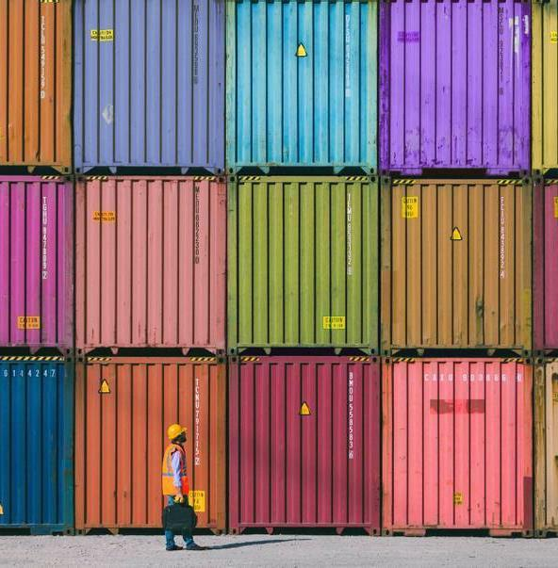
Video Clustering using image descriptors
Wajih Ullah Baig

Slide 2

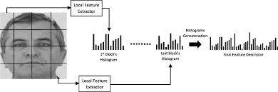
Agenda
Purpose
Image Features
Code demo

Slide 3
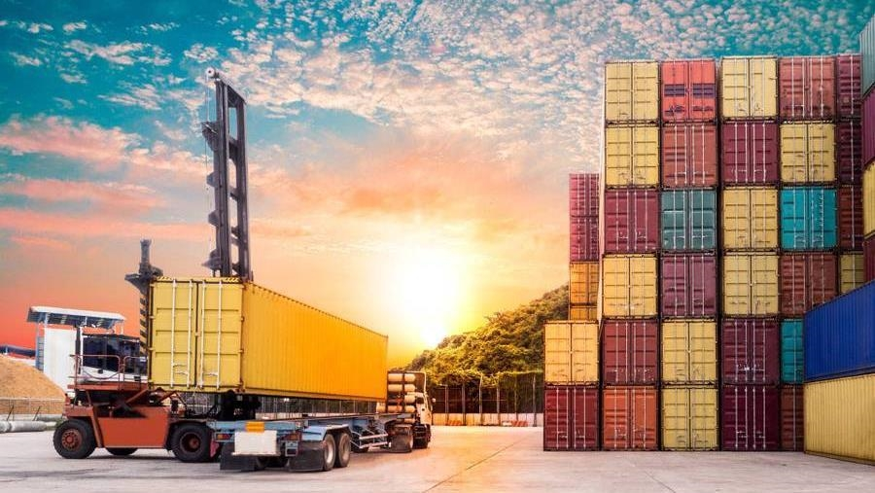
Purpose
How to use image descriptors and perform clustering. This is an example of unsupervised machine learning where we can drop into some details.
Process a video
Extract features
Cluster
Visualize
Create a GIF animation (Create video highlights)
A little touch to coding practices

Slide 4
Image Features
An image features is a way to describe an image. This is part of computer vision where we try to help a computer understand an image. Sometimes also called descriptor or feature.
There are many, some are local some are global or holistic image features. For example, SIFT, SURF, ORB, BRIEF,GIST
Here we will be talking about LBP and HoG features

Slide 5
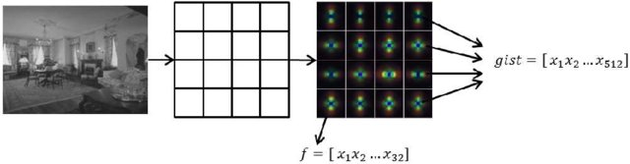
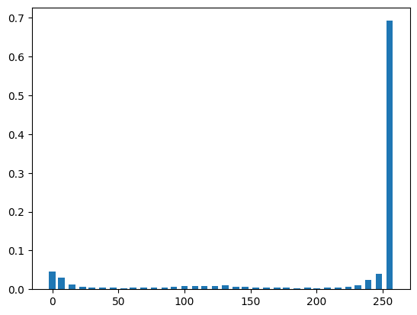
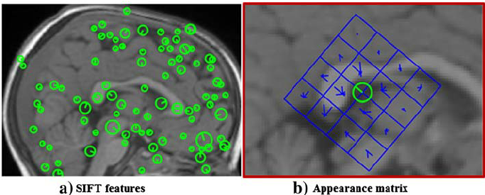
Types of descriptors
Holisitic (Global)
GIST, LBP, HoG
Local
SIFT, SURF
gist image sift image

Slide 6
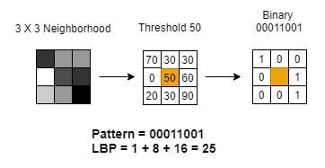
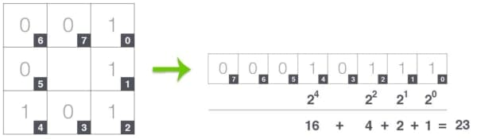
LBP (Local Binary Pattern) features encode local texture information, which you can use for tasks such as classification, detection, and recognition. The function partitions the input image into non-overlapping cells. To collect information over larger regions, select larger cell sizes Local Binary Pattern

Slide 7
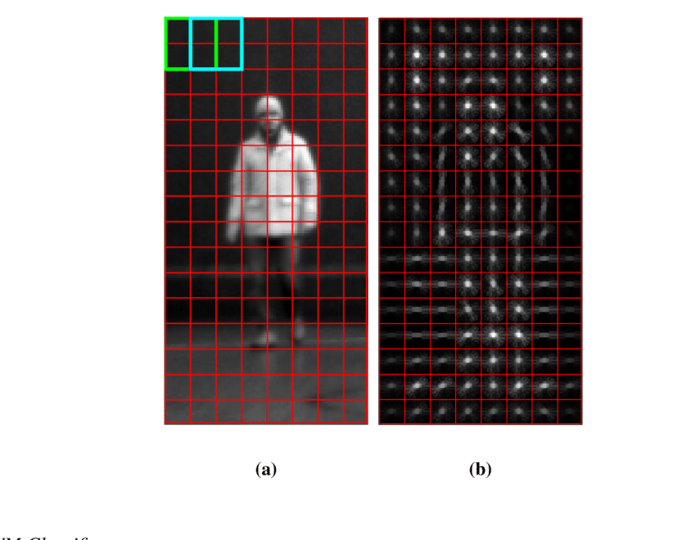
The HOG algorithm divides an image into small cells, computes each cell's gradient orientation and magnitude, and then aggregates the gradient information into a histogram of oriented gradients Histogram of Oriented Gradients
Scikit HoG descriptor
Image

Slide 8
Video clustering
Unsupervised machine learning

Slide 9
Steps
Read video
Process frame by frame, extract features (1D array)
Normalize features
Accumulate for Kmeans
Find optimal K
Cluster
Create highlight (animated GIF)
Visualization of different steps

Slide 10
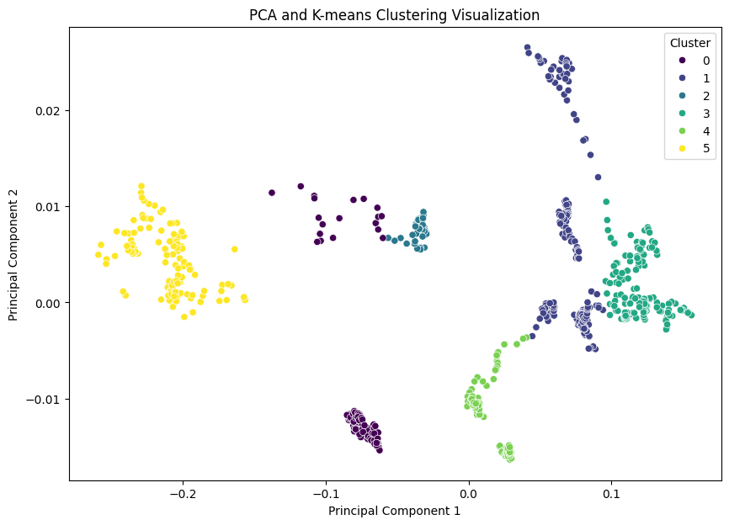
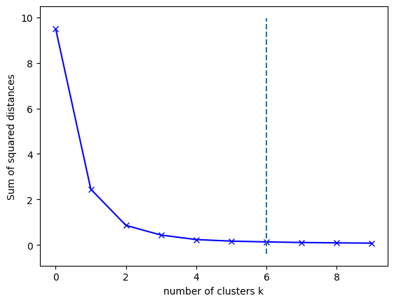

Slide 12
THANK YOU
Wajih Ullah Baig
https://github.com/wajihullahbaig/video_clustering

